Slide 1
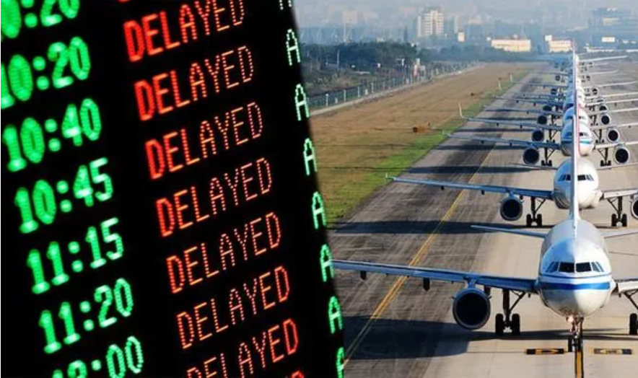
Predicting Flight Delays Team 07
Michael Bollig
Emily Brantner
Sarah Iranpour
Abhi Sharma
7/20/2021
Notes:
Abhi

Slide 2
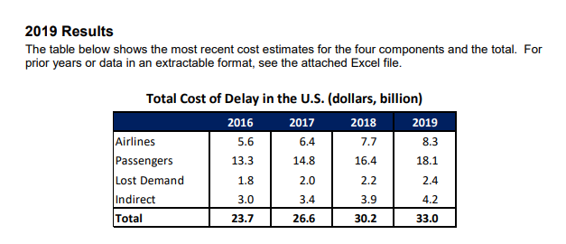
Introduction & Motivation
Source: https://www.faa.gov/data_research/aviation_data_statistics/media/cost_delay_estimates.pdf
Notes:
Abhi

Slide 3
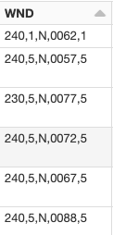
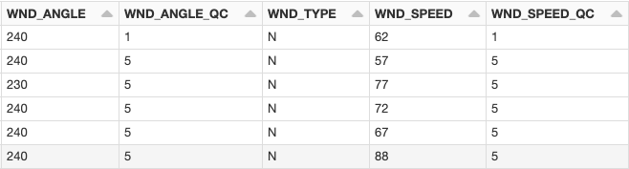
EDA - Cleaning
Removed unnecessary and sparse columns
Unpacked and format columns in weather data
Formatted and converted time to UTC
Denote Canceled flights as “Delayed”
Notes:
Emily
Used spark sql and pyspark
Airline
Updated airlines dataset to included canceled as delayed
Included diverted delays in the arrival delay times
Created a timestamp from the date and time information, then converted to UTC with the openflights.org dataset to get the timezone
Stations
Removed some unnecessary columns (extras for states, etc)
Weather
Pulled some of the columns apart- see image
Removed some of the later columns that were mostly null

Slide 4
EDA - Joining
Flights table is our core data
Joined on ICAO airport codes, from openflights.org using the IATA airport codes
Joined on weather station IDs from station table for local stations using the ICAO codes
Joined on weather data from weather table using the station ID’s and the UTC timestamps at the intended prediction time
Timestamps joined on a range
Notes:
Michael

Slide 5
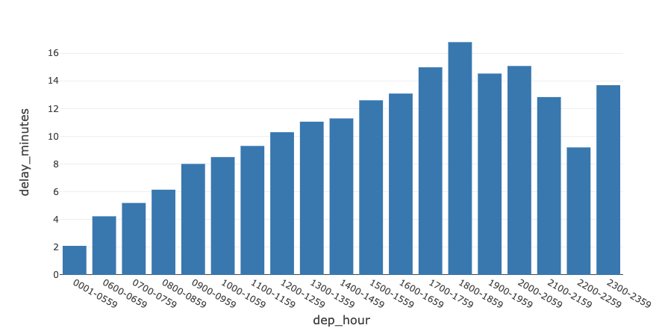
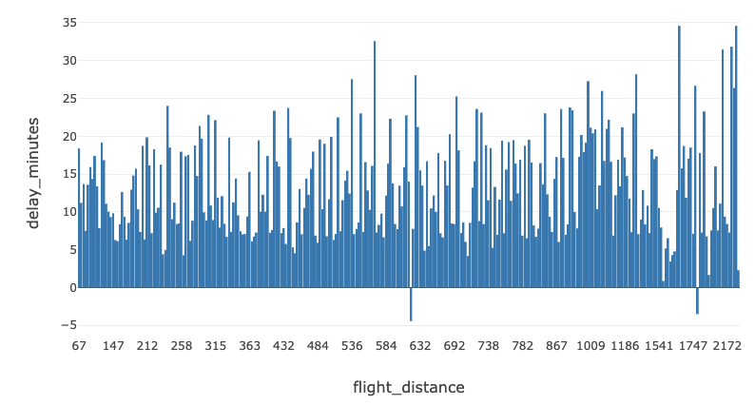
EDA - Distribution of potential features
Notes:
Sarah

Slide 6
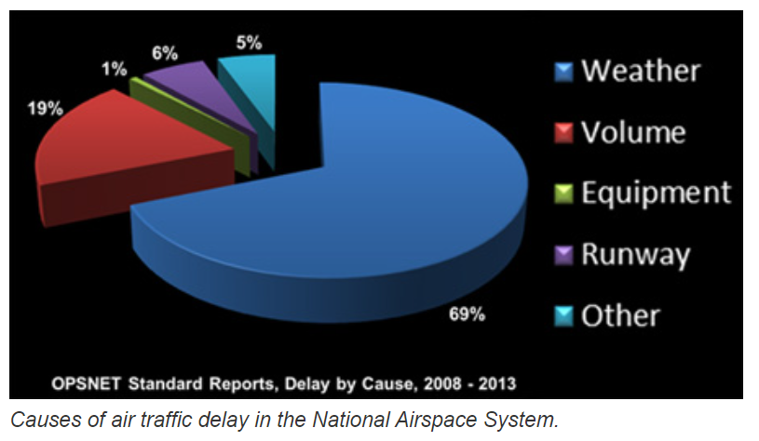
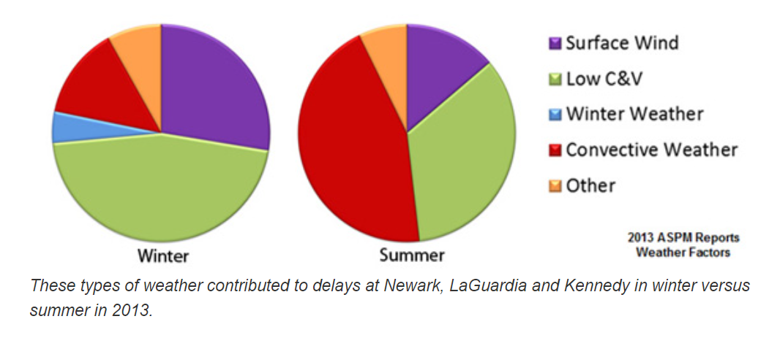
Feature Exploration & Motivation
Weather* includes - extreme weather (uncontrollable) & NAS (controllable) delays
Volume (air traffic) - next biggest component
Source: https://www.faa.gov/nextgen/programs/weather/faq
Notes:
Sarah

Slide 7
Feature Wish List (Volume)
Feature | Remarks
Num_Delays_X_Hours_Airport | # Delays at airport X hours before departure of a flight (“Snowball Delay” effect on all airlines at the airport)
Num_Delays_X_Hours_Airline | Highlights Airline specific issues
Num_Delays_Total_Day | Global counter that may be affecting all airports / airlines (FAA emergency rule, terrorist attack, Covid worldwide halt)
Notes:
Sarah

Slide 8
EDA - Feature Selection (Current)
Feature
Month | Group months into seasons
Day of week | Longer and more delays on certain days
Hour of day | Longer and more delays in the afternoons
Carrier | Certain carriers have longer delays compared to others
Airport | Airports with more delays; weather at departure and destination airports
Flight distance | Longer flights seem to have longer delays; Distance also a proxy for flight time
Notes:
Sarah

Slide 9
EDA - Feature Selection (Next Steps)
Weather features
Visability, dewpoint, wind, etc.
Correlation testing
Multicollinearity
Feature transformations
Notes:
Sarah

Slide 10
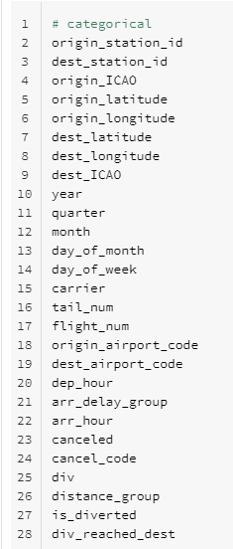
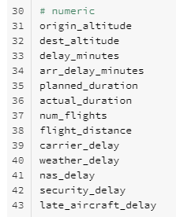

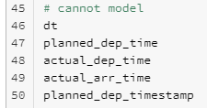
Feature Categorization (Binomial)
Notes:
Abhi

Slide 11
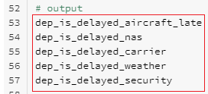
Feature Categorization (MultiNomial)
Notes:
Abhi

Slide 12
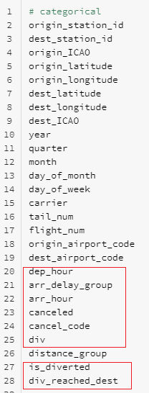
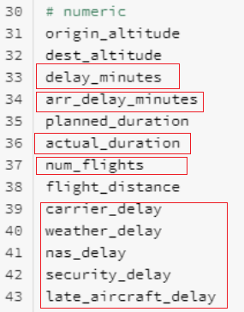
To Model or Not To Model...
Notes:
Abhi

Slide 13
Logistic Regression (Next Steps)
Classify this as a binomial classification (dep_is_delayed)
Classify this as a multinomial classification (Delay by reason - security, weather, NAS, carrier)
Perform simple classification for quarterly dataset
Assess performance
Scale to full dataset
Notes:
Abhi

Slide 14
Thank you for your time!

Slide 15
Open Questions
The sum of late_aircraft_delay, security_delay, nas_delay, weather_delay, carrier_delay - should either add up to sum of departure delay (delay_minutes) and arrival delay (arr_delay_minutes). Need to investigate cases where this is not true.

